Slide 1
Advanced Techniques with Large Language Models Lecture 7
Northeastern University
College of Engineering
Multidisciplinary Graduate Engineering Department
INFO 6105 – Fall 2024
Instructor: Abdolreza Mosaddegh

Slide 2
LLM Applications Other Than Text Generation
An LLM might respond to a prompt from aspect of text generation which is not necessarily aligned with user intent
There are many different applications of LLMs such as question answering, sentiment analysis, coding, etc. which are not aligned with text generation
Although LLM capabilities for generating text can be used for many applications, they need to train for responses aligned with user intent
Question Answering without Finetuning:
Prompt: “teach me how to bake bread”
Response: “in a home oven.”

Slide 3
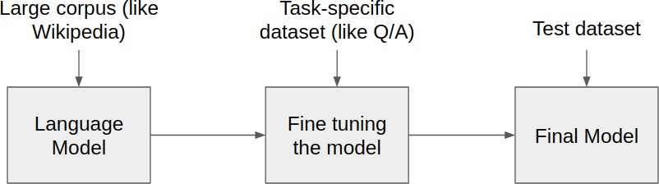
Solution: Fine-Tuning
LLMs undergo a two-stage training process:
Pre-Training: The model learns general knowledge from a vast and diverse datasets. This phase helps the model encode generic linguistic features and knowledge which can be effectively employed in the target applications
Fine-tuning: The pre-trained model is fine-tuned on a smaller, task-specific dataset, adjusting its general knowledge to perform well on specific task (downstream tasks)

Slide 4

Fine-tuning vs Training From Scratch
General knowledge and capabilities of LLMs is required for many tasks
The “large” in “large language models” refers to the huge number of parameters in these models which needs huge computational resources for training.
Pre-training an LLM for any specific purpose is impractical.
Task-specific training usually needs labeled data which is less available than general text
Fine-tuning an already-trained LLM requires far less data and less computational power.
Step 1: Pretrain (on language modeling)
Huge text data - learn general knowledge
Step 2: Finetune (on specific task)
Not many, labeled; adapt to the task
goes to
make tasty tea END
Sentiment Analysis
LLM
LLM
Iroh
goes
to
make
tasty
tea
the movie was good …

Slide 5
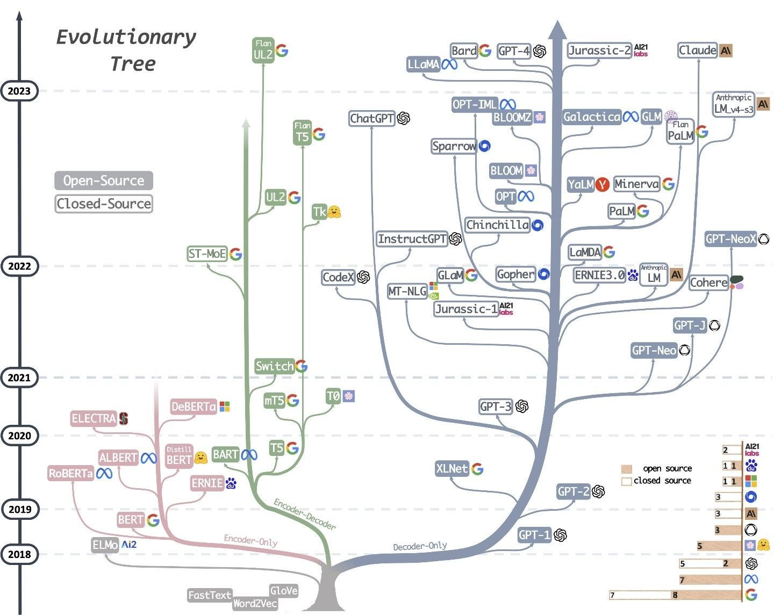
LLMs as a Base Model for Fine-tuning
Open-source models where the pre-trained corpus is transparent, and we have full access to their pre-trained weights. Highly customizable but typically smaller models
Closed-source/proprietary models: we don’t know about their pre-training corpus, and don’t have access to their pre-trained weights, and can only do inference or fine-tuning through APIs (e.g., GPT 4o). Typically, large models with Limited customization
Complexity of tasks and customization requirements are main factors for selecting open/closed source models

Slide 6
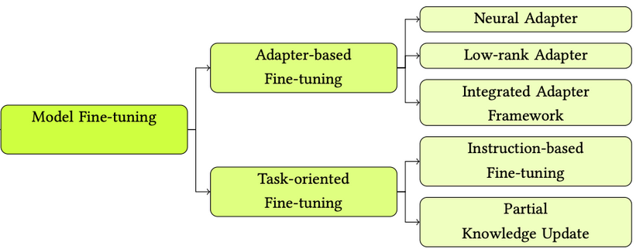
Fine-tuning Approaches
Prompt Tuning (without weight updates)
Full Finetuning
Partial Finetuning (Frozen Backbone)
Feature-Based Finetuning (Feature Extractor + Task-Specific Heads)
Adapter-Based Finetuning
Parameter-Efficient Finetuning (PEFT)
Instruction Tuning

Slide 7
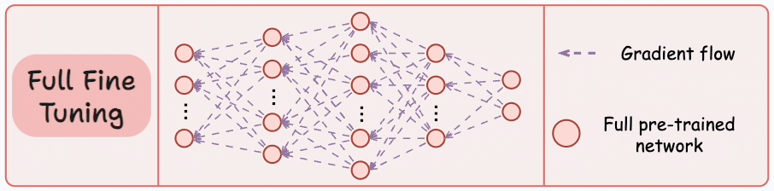
Full Fine-Tuning
Involves training all layers of the model on a new dataset
Update the weights of all the parameters using backpropagating
Provides the most flexibility and potential for high performance.
Useful for highly specific tasks where maximum model adaptation is needed.

Slide 8
Multi-Task Fine-tuning
The same model architecture is used for all tasks, with a common base of parameters across tasks.
Leverage shared knowledge across related tasks, improving overall performance by generalizing knowledge
Step 1: Pretrain (on language modeling)
Huge text data - learn general knowledge
Step 2: Finetune (on multiple tasks)
Works better comparing one-task fine-tuning even for that tasks
goes to
make tasty tea END
Sentiment Analysis, Question Answering, etc.
LLM
LLM
Iroh
goes
to
make
tasty
tea

Slide 9
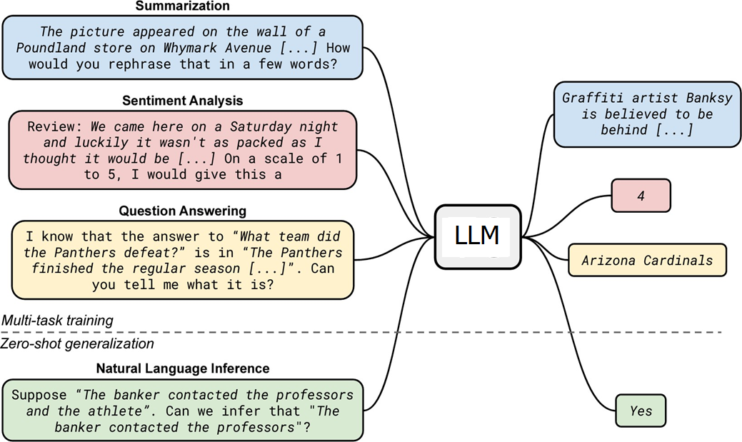
Multi-Task Fine-tuning - Considerations
Task Similarity:
Tasks that are related tend to benefit more from multi-task finetuning.
Task Difficulty:
If one task is significantly harder than others, it may dominate training. Careful task sampling and loss balancing can help mitigate this.
Generalist LLMs:
General purpose LLMs are often trained on multiple tasks to improve generalization and performance across diverse applications.

Slide 10
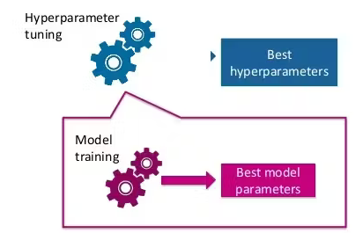
Hyperparameter Sensitivity in Full Finetuning
Fine-tuning requires carefully adjusting hyperparameters (e.g., learning rate, epochs, batch size) to prevent underfitting or overfitting.
Larger models are more sensitive to these hyperparameters, making the process of tuning more challenging.
Before final fine-tuning investigate the best set of hyper-parameters :
Use best practices for candidate settings
Use training loss to evaluate settings
Use validation / test data to evaluate settings
Compare the results of different settings

Slide 11
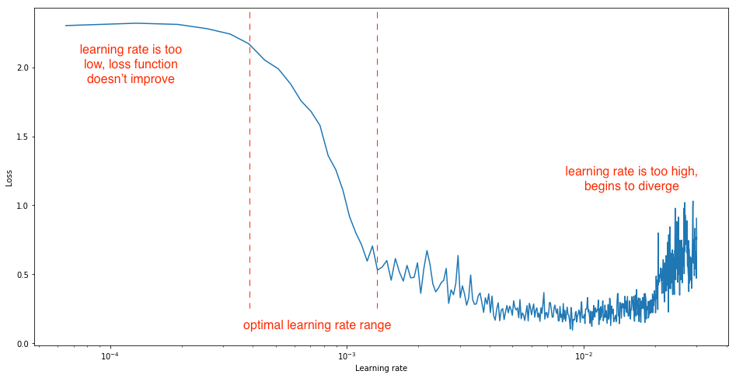
Hyperparameters – Learning Rate
Catastrophic Forgetting: A high learning rate can cause the model to quickly forget knowledge learned during its initial training phase.
Overfitting to New Data: High learning rates heighten the risk of overfitting particularly if dataset is small, reducing generalization
Underfitting: A low learning rate might prevent the model from effectively adapting to the new data, especially if the model needs substantial updates to learn new patterns.
Convergence Problem: With a low learning rate, the model will update very gradually and might not converge to the optimum
Gradual Warm-Up and Decay of Learning Rate can be helpful

Slide 12
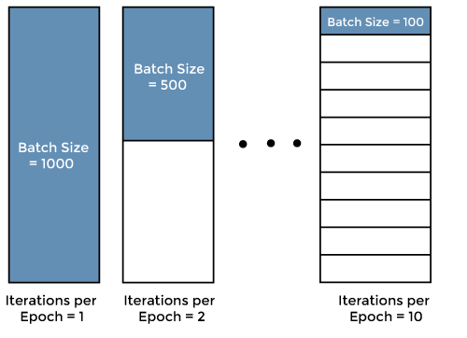
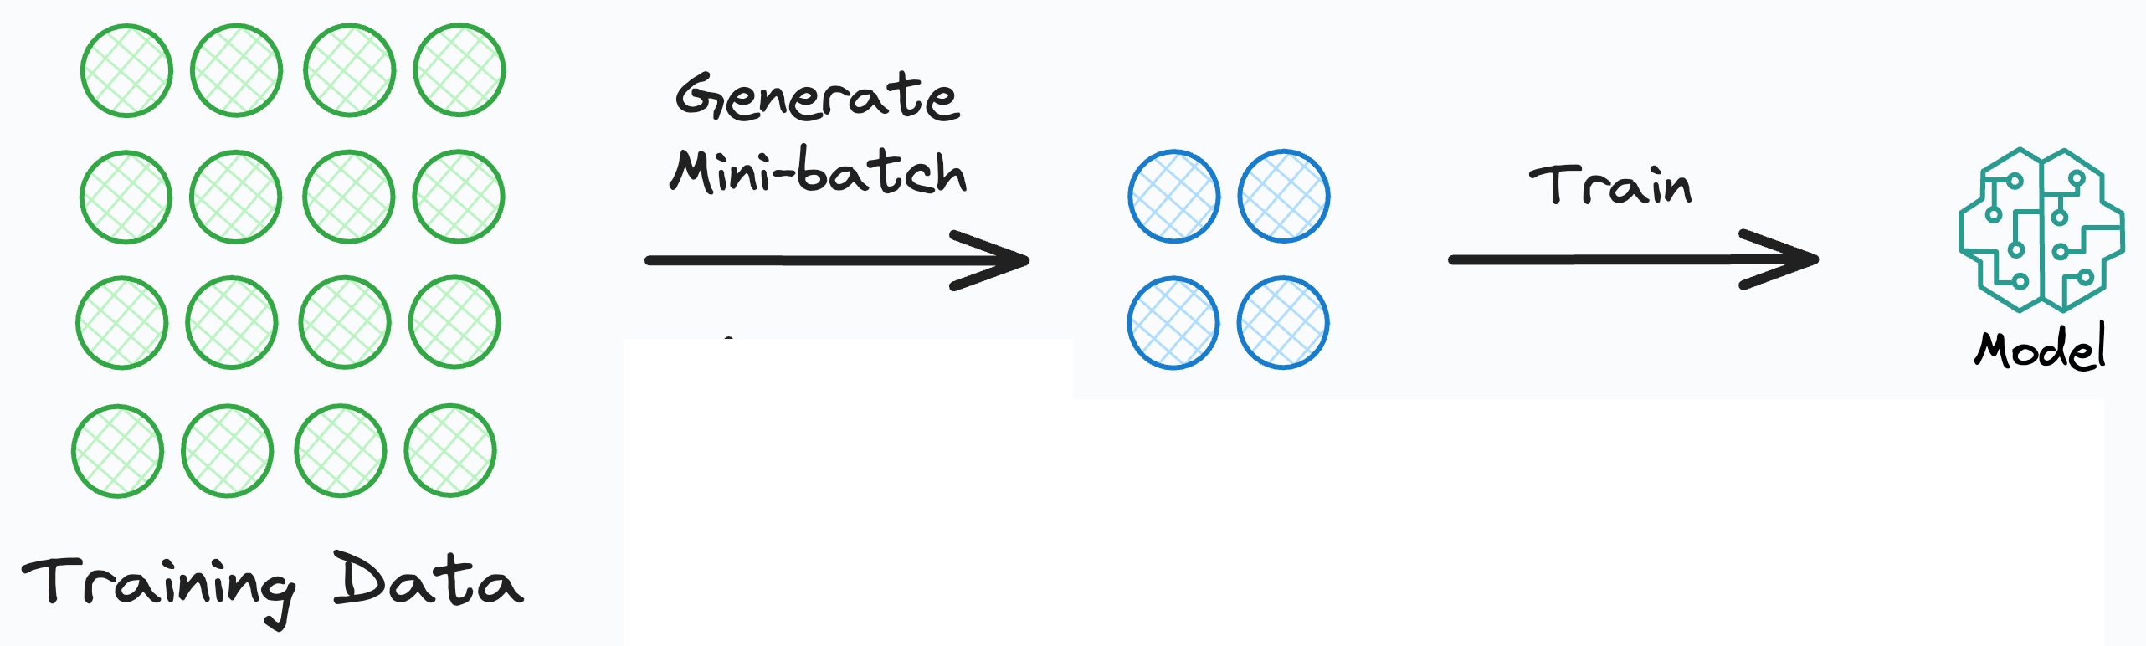
Hyperparameters – Batch Size
Generalization: While small batch sizes can sometimes enhance generalization, too small a batch size risks overfitting to the noise in the data.
Sensitivity to Learning Rate: Smaller batch sizes can make training more sensitive to the choice of learning rate. With too high a learning rate, small batches can produce erratic gradients.
Limited Gradient Diversity: A large batch size may capture the average gradient well but can prevent the model from adapting effectively to nuanced patterns in the fine-tuning data.

Slide 13
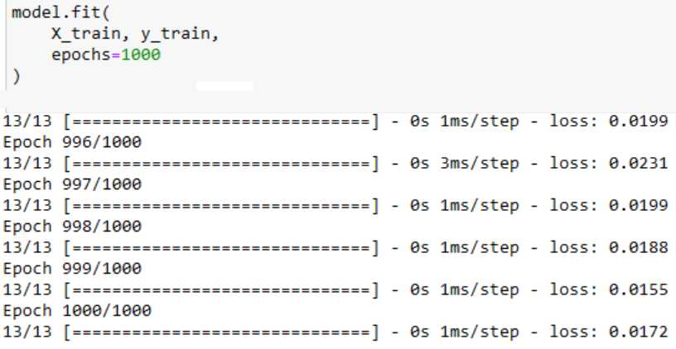
Hyperparameters - Epochs
Catastrophic Forgetting: With too many fine-tuning epochs, there is a risk of catastrophic forgetting, potentially harming performance on a range of other tasks.
Decreased Model Flexibility: With excessive fine-tuning, the model may become too specialized, losing its flexibility to handle a diverse set of queries
Underfitting: With too few epochs, the model may not have enough time to learn the patterns in the fine-tuning dataset.
Sensitivity to Learning Rate: If the fine-tuning is done with a low learning rate, a small number of epochs may not allow the model to make meaningful progress.

Slide 14
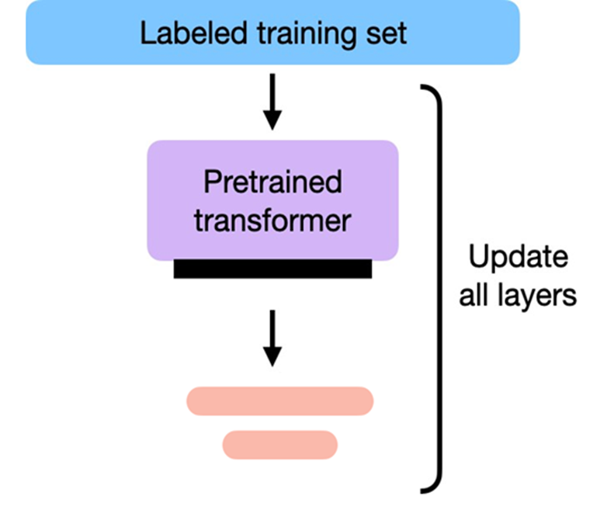
Full Fine-Tuning - Challenges
Risk of loss of Pre-trained Knowledge (Catastrophic forgetting)
Risk of overfitting to fine-tuning data (especially if the dataset is small)
Sometimes reduce the model's ability to generalize to other tasks
Requires significant computational resources and time.

Slide 15
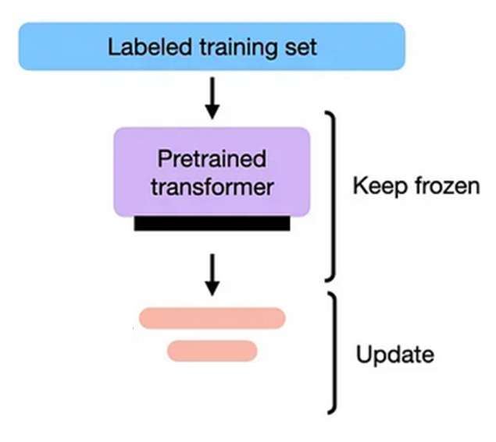
Partial Fine-tuning
Only a subset of the model's layers (usually the later layers closer to the output) are trained while the rest of the model remains frozen (unchanged)
In LLMs, earlier layers capture more general and low-level features (e.g., syntax), while later layers capture more complex and task-specific features
General Knowledge
Task-specific Knowledge

Slide 16
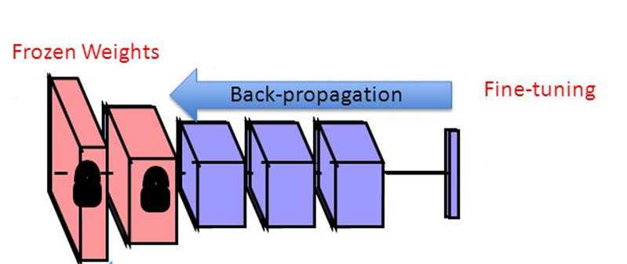
Benefits and Challenges
Less computational resources compared to full fine-tuning
Better for small datasets since less parameters needs to be trained
Reduces risk of overfitting since most parameters are frozen
Reduces risk of catastrophic forgetting since most parameters are frozen
Effective when domain-specific adaptation is needed but the core knowledge should remain intact
Sometimes insufficient for complex tasks

Slide 17
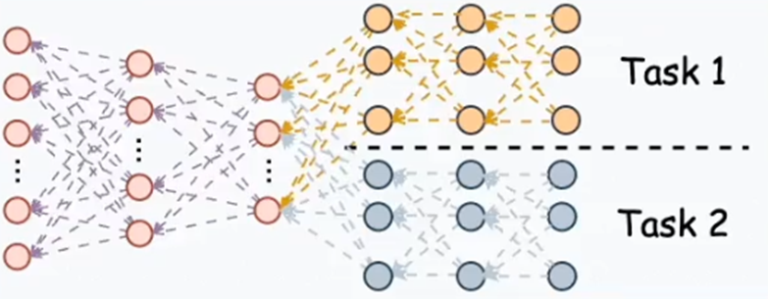
Feature-Based Finetuning
While the backbone is shared, separate output layers (task-specific heads) are often used for each task. Task-specific heads can be:
Classification head (for tasks like text classification, sentiment analysis)
Regression head (for tasks like predicting a continuous variable)
Generation head (for tasks like text generation or translation)

Slide 18
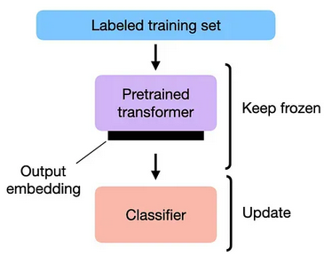
Feature-Based Finetuning
Task-Specific Head: task-specific output layers can be feed forward layers (e.g., for classification) on top of the pre-trained model.
Frozen Pre-Trained Layers: The pre-trained model's internal parameters are frozen.
Fine-Tuning on Task-Specific Data: Train the model on task-specific labeled data updating only the parameters in the heads.
The pretrained model is used as a feature extractor, and only a task-specific head is finetuned while the rest of the model remains frozen

Slide 19
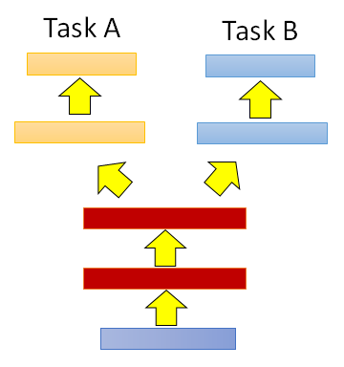
Task-specific Heads
Since only a small portion of the model (the head) is trained, it is computationally efficient
Since only the head is trained, it works well on small task-specific datasets
Preserving pre-trained knowledge on frozen layers prevents catastrophic forgetting
frozen feature layers may restrict the model from learning task-specific features that could improve performance of heads.
Frozen Layers

Slide 20
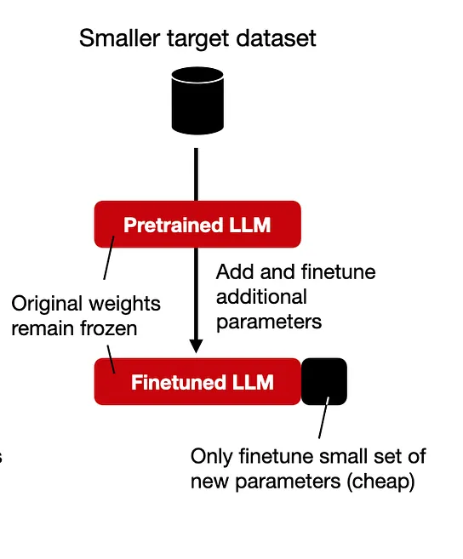
Parameter-Efficient Fine-Tuning
Rather than fine-tuning the parameters in the entire model, only fine- tune a small set of weights.
Adapter-Based: add a small external neural network for each task
Reparameterization: reparametrize the model parameter to be more efficient for training (e.g.,LoRA)

Slide 21
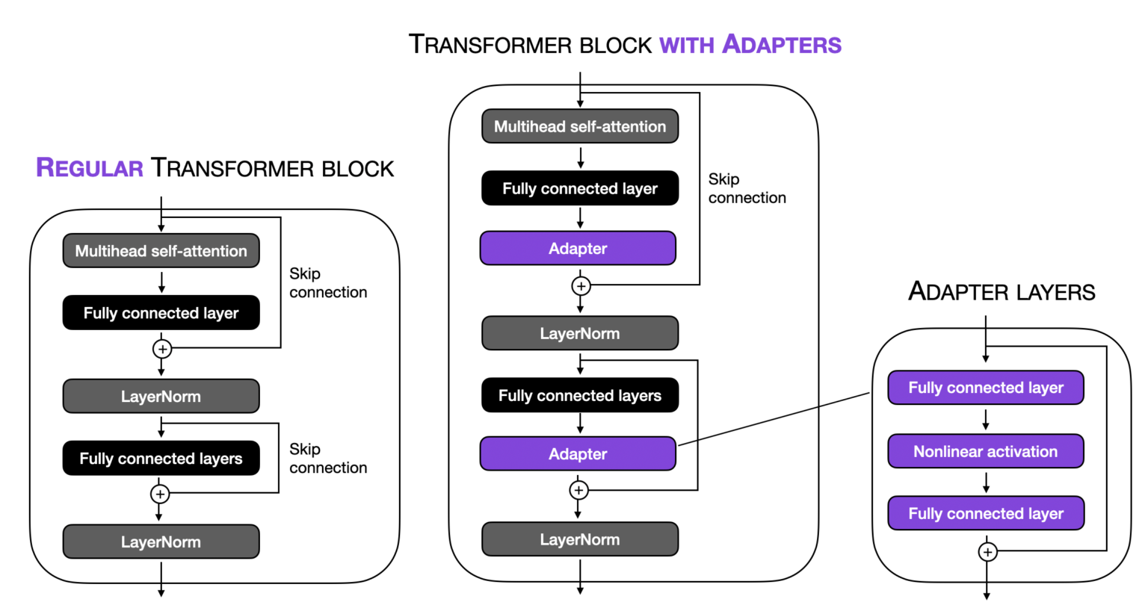
Adapter-based Methods
Adapter modules injecting new layers into layer of the pre-trained model
Typically, these layers consist of a small feedforward neural network that transforms the input from the preceding layer and pass it to the next layer
During training, the original network weights are untouched, only the adapter weights are updated.

Slide 22
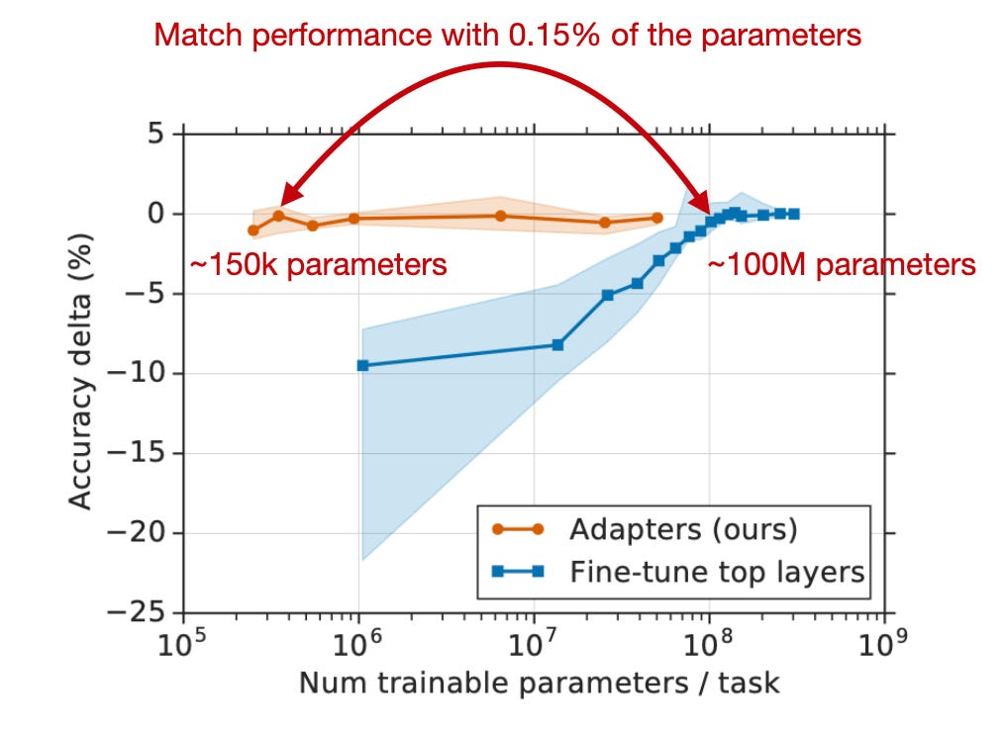
Adapter-Based Fine-Tuning
Requires fewer computational resources
Reduces risk of catastrophic forgetting
Can be used across multiple tasks by switching adapters
Can achieve a similar performance to full / partial fine-tuning with much less re-trained parameters.
May not achieve as high performance as full fine-tuning on some tasks.
Requires implementation of adapter layers in the model architecture.
Make the model size larger

Slide 23
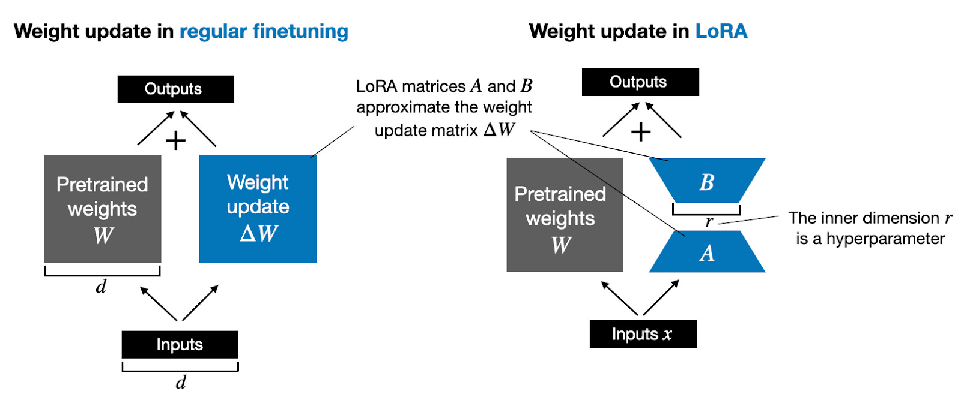
Low-Rank Adaptation (LoRA)
LoRA is a reparameterization method to fine-tune large-scale models efficiently by targeting a small subset of the model’s weights that have the most significant impact on the task at hand. LORA achieves this by:
Tracking changes to weights instead of updating them directly.
Decomposing large matrices of weight changes into smaller matrices that contain the “trainable parameters.”

Slide 24
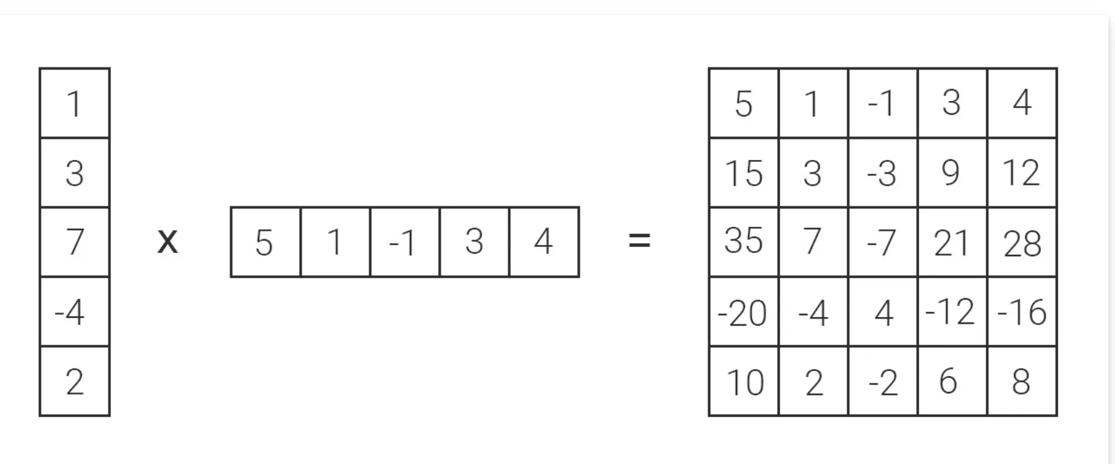
Low-rank Matrices - Example
Imagine a 5x5 matrix as a storage unit with 25 spaces.
LORA breaks it down into two smaller matrices through matrix decomposition with “r” as rank(the dimension): a 5x1 matrix (5 spaces) and a 1x5 matrix (5 spaces).
This reduces the total storage requirement from 25 to just 10, making the model more compact.
5 x 1
1 x 5
5 x 5

Slide 25
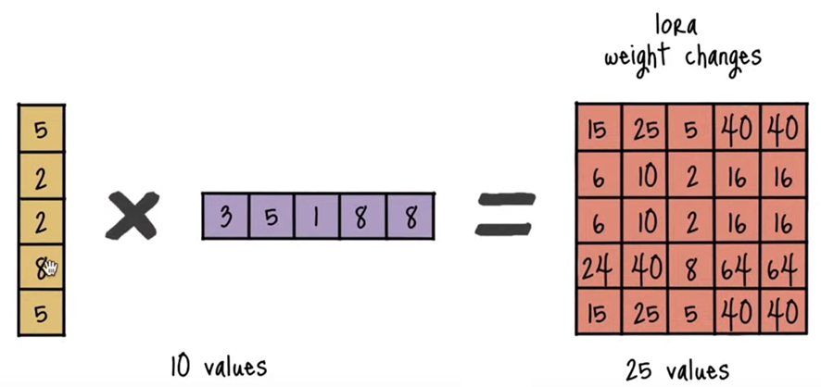
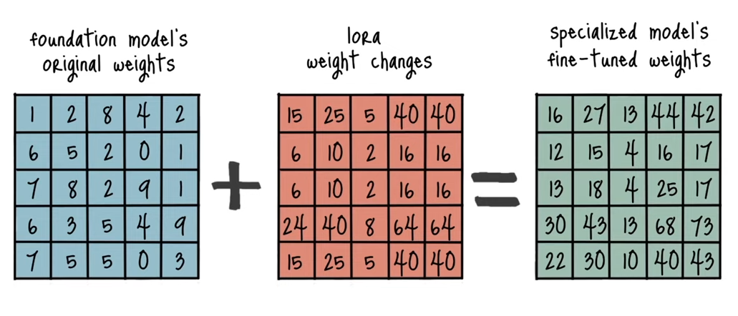
Training Process with LORA
During training, only the parameters of the change matrices(low-rank matrices) are updated. The rest of the model remains unchanged (frozen)
Backpropagate to update the low-rank matrices
The output of the fine-tuned model now comes from the combination of the original weights and the adapted matrices.
This allows the model to retain its original knowledge while adapting to the new task.

Slide 26
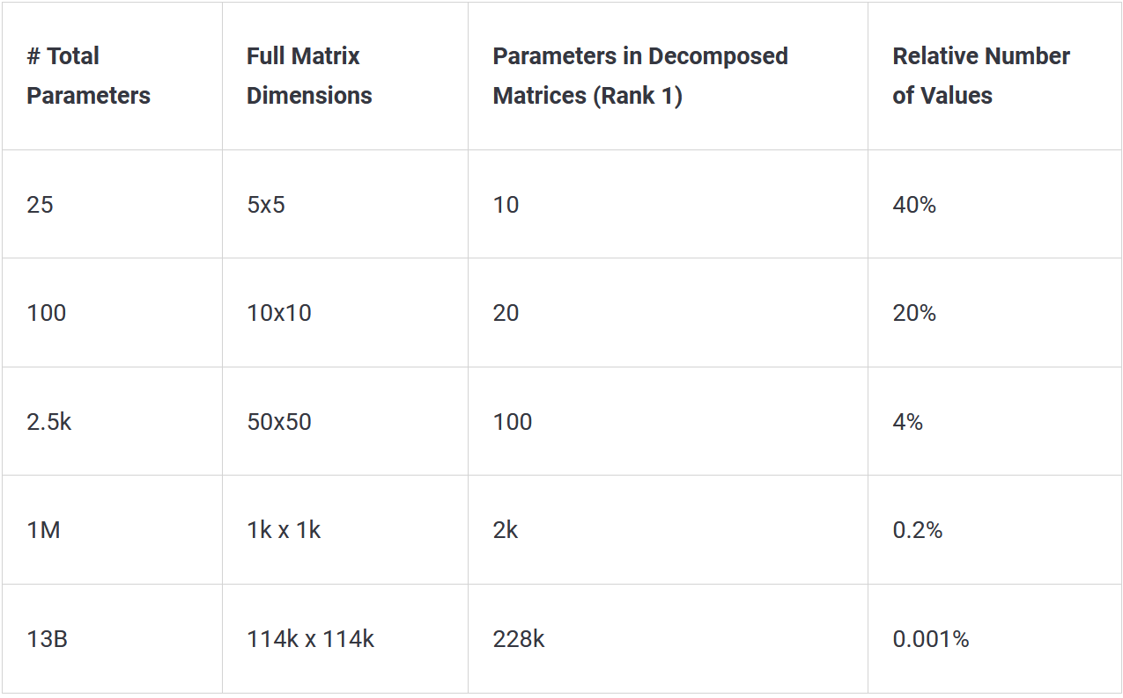
Parameter-Efficiency in Large Models
Working with decomposed matrices reduces the number of involved parameters significantly, especially in huge models
Not only does this save space, but it also accelerates computations. Working with smaller matrices involves fewer calculations, leading to faster fine-tuning.

Slide 27
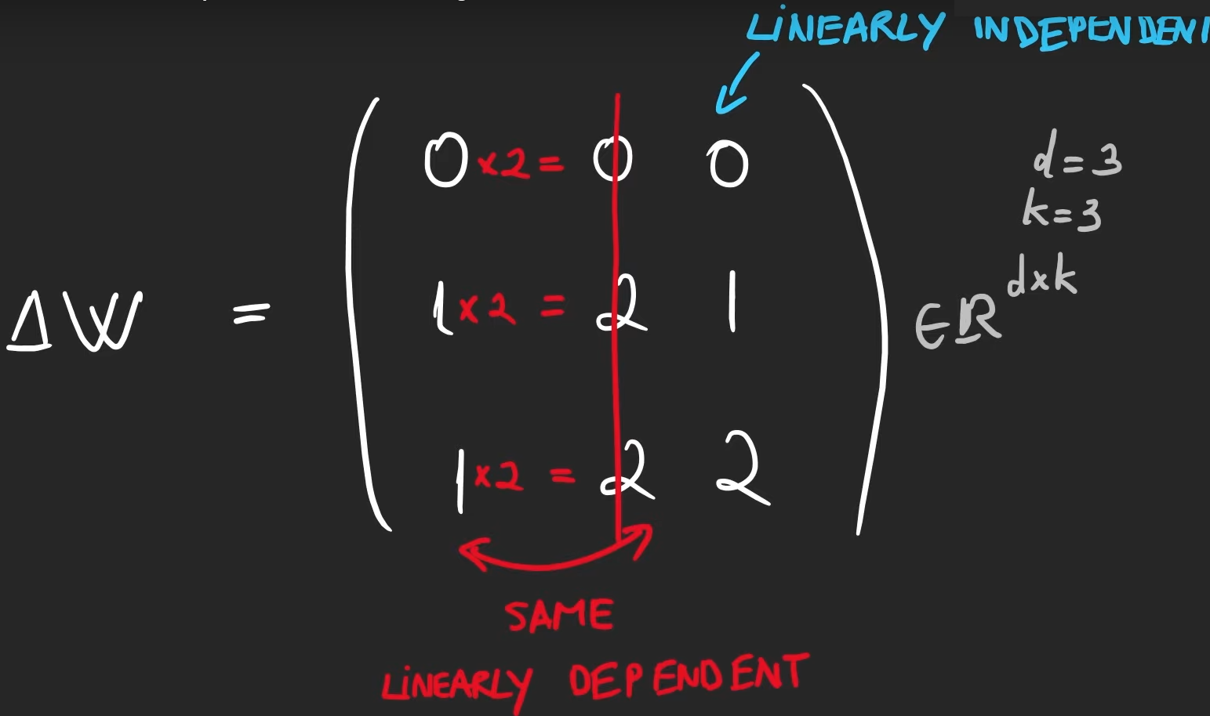
Why LoRA works?
LLMs pre-trained on huge data learn on a wide variety of tasks.
Improve performance / fine-tune LLM to a subset task, usually don’t need a lot of weights to be changed.
These models are bigger than they need to be for the training data(over-parameterized), and not all of the parameters strictly matter (low intrinsic dimension)
There is also redundancy and linear correlation within the parameters.

Slide 28
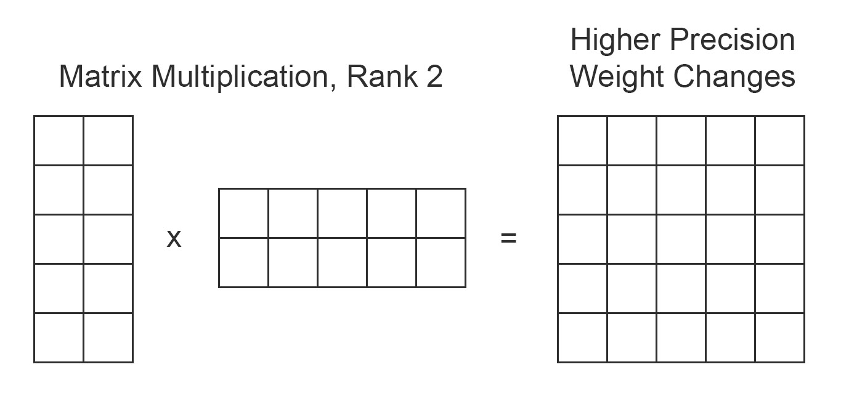
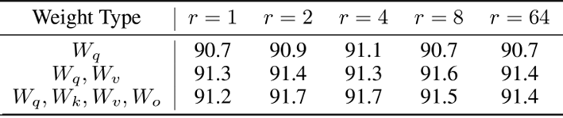
Increasing the Precision of LoRA
In principle, LoRA can be applied to any weight matrices in deep learning, but it’s often used on attention block.
Increase the rank of change matrices make LoRA method more precise
Output matrix is the same size but change matrix encode more information, therefore the resulting numbers are more precise
Validation data can be used for finding optimal rank

Slide 29
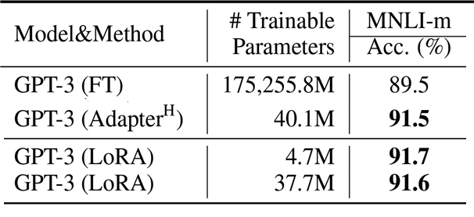
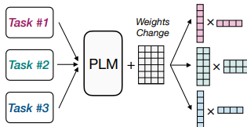
Benefits of LoRA
Significant reduction in trainable parameters, leading to faster and more efficient fine-tuning.
Preserving the original pre-trained weights avoids catastrophic forgetting
Allowing for multiple lightweight models for different tasks.
Comparable performance to fully fine-tuned models in many cases.
LoRA can be done in parallel suitable for GPU despite adaptor based

Slide 30
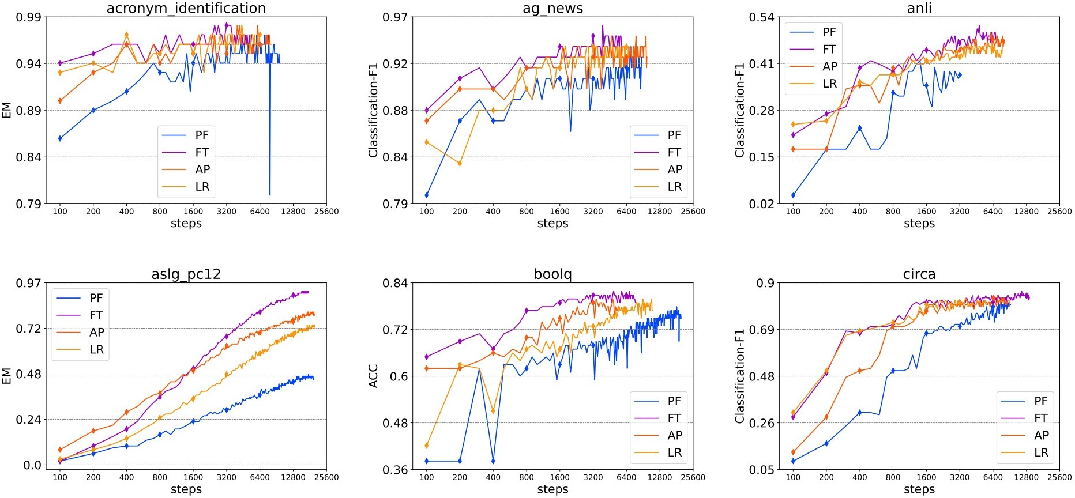
Performance Comparison on Various NLP Tasks
Performance on T5-base with enough data and computing resources:
Full Fine-tuning > LoRA > Adapters > Prompt Tuning
Delta Tuning: A Comprehensive Study of Parameter Efficient Methods for Pre- trained Language Models (Ding et. al, 2023)

Slide 31
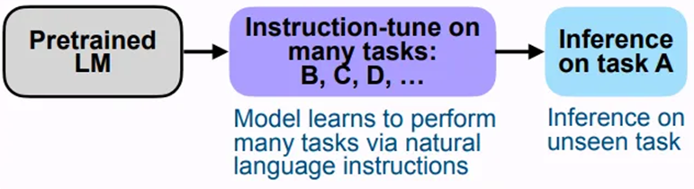
Instruction Tuning
Instruction tuning is a technique for fine-tuning large language models (LLMs) on a labeled dataset of instructional prompts and corresponding outputs.
Instruction tuning augments input-output training data with instructions
Instruction tuning is not mutually exclusive with other fine-tuning techniques.
Instruction tuning may include many tasks enables LLMs to respond accurately to a wide range of task instructions

Slide 32
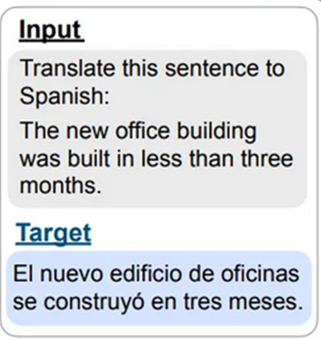
Instruction Tuning
Each training sample in an instruction dataset comprises :
An instruction: A natural language text input that specifies a given task. For example, “Diagnose a patient with following condition:”
Input Context: Information that provides context relevant to the task at hand. For example, “The patient has fever”
Desired output: The target output (response) for the given prompt. This will serve as a ground truth against which the model’s predictions are evaluated and optimized. For example, “The diagnosis is sepsis”

Slide 33
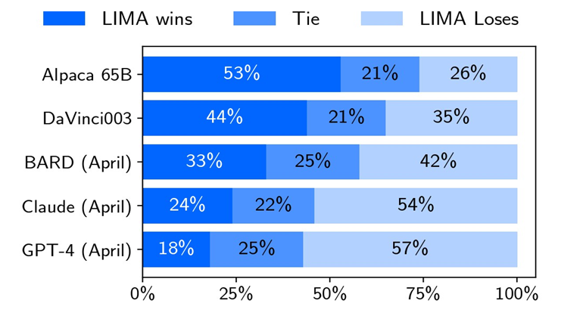
Effectiveness of Instruction Tuning
LIMA, a 65B parameter LLaMa fine-tuned using instruction tuning
Only 1,000 prompts and responses
Results strongly suggest that only limited instruction tuning data is necessary to teach models to produce high quality output.
Data quality and diversity are the keys
LIMA: Less Is More for Alignment (Zhou et. al, 2023)

Slide 34
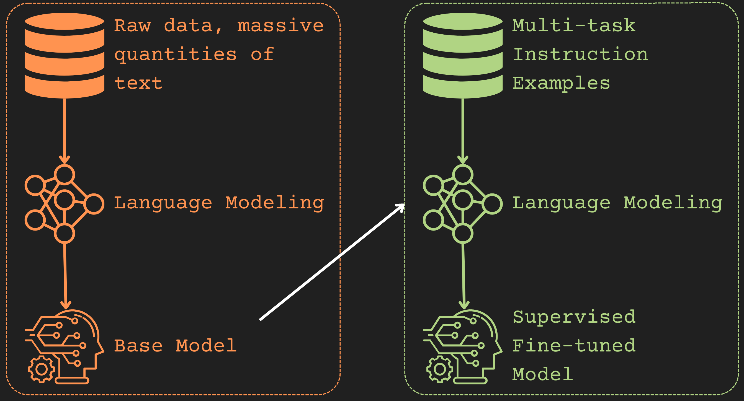
Reason of Effectiveness
Most of knowledge in LLMs is learned during pretraining since they trained on a huge amount of data containing vast range of knowledge.
Autoregressive models do not answer a prompt, they learned to append most probable text to it which is not necessarily aligned with user intent.
Most of the time LLMs don’t need to learn entirely new knowledge during fine-tuning but they need to learn using that knowledge to generate responses aligned with user intent.
Instruction tuning helps to make appended text aligned with user intent

Slide 35
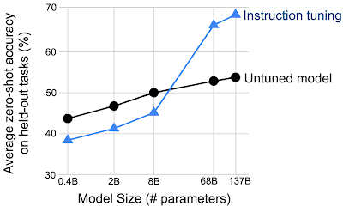
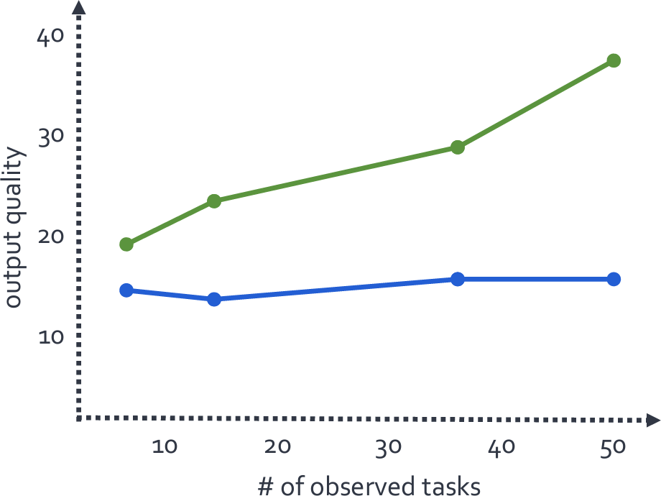
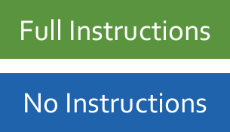
Instruction Tuning – Improvements
Instruction tuning tends to be more effective on larger models since they store more knowledge during pretraining and just need to learn desired outputs (Qin et al., 2024)
The greatest improvements are on tasks that are naturally articulated as instructions, like question-answering, and reading comprehension (google)
Adding additional tasks to the instruction tuning dataset improves the instruction-tuned model’s performance even on novel tasks that are not represented in the instruction dataset (google).
Instruction tuning makes an improvement in the model’s ability to follow instructions in general (google).

Slide 36
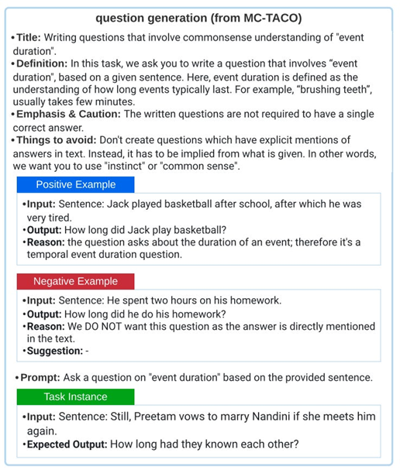
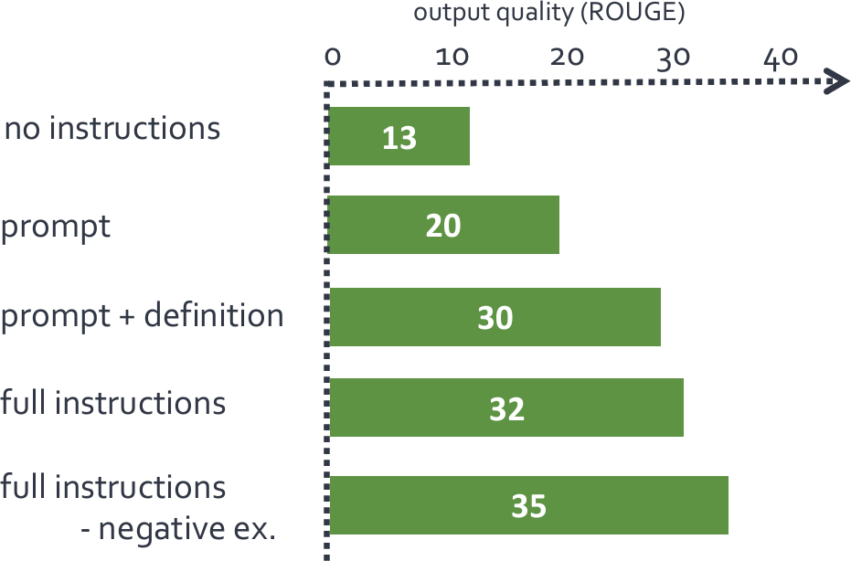
Generalization to Unseen Tasks
BART model (140M params) is fine-tuned using instruction-tuning
All instruction elements (except negative examples) help improve model performance on unseen tasks.
Mishra et al., 2022

Slide 37
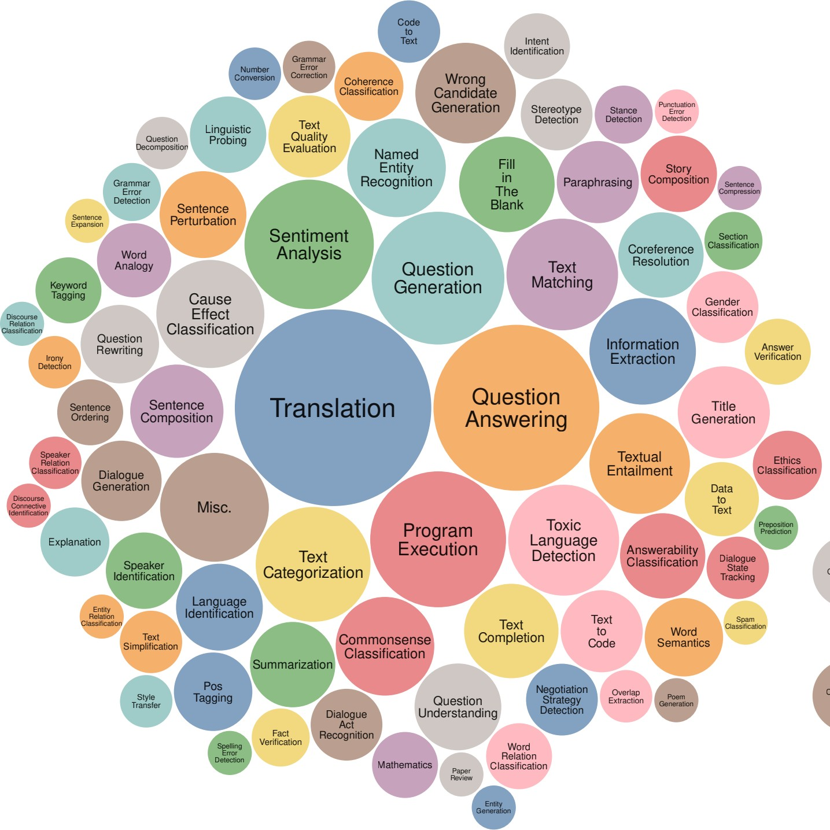
Instruction Tuning Best Practices
Mixing few-shot settings. Training with few-shot prompts significantly improves performance.
Task diversity. Large models benefit from continuously increasing the number of tasks.
Data augmentation. Augmenting the data such as by inverting inputs and outputs is beneficial.
Data size, diversity and model scale are critical for a successful multi task tuning
Wang et al., 2022

Slide 38
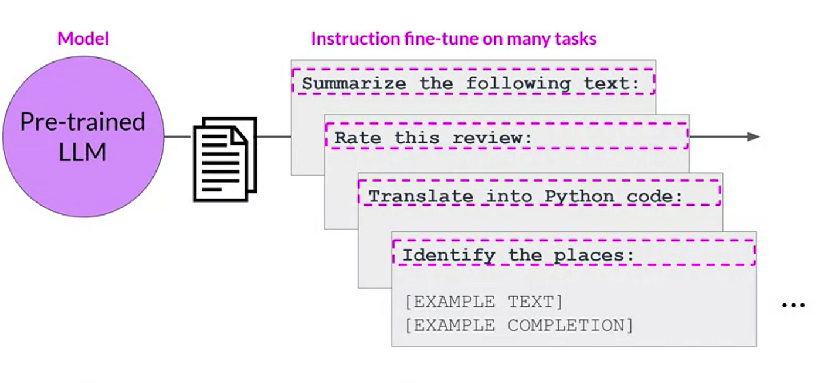
Advantage and Challenges of Instruction Tuning
Training-data efficient (Works even on small datasets)
Can be done for many tasks in parallel
Performance depends on quality of instructions
May require large models to fully realize its benefits
Supervised instruction tuning is labor intensive since it needs to pair every instruction with a desired output
Without human feedback, assessing the performance of instruction-tuned models can be difficult, as traditional metrics may not adequately capture how well the model follows user instructions or understands intent.

Slide 39
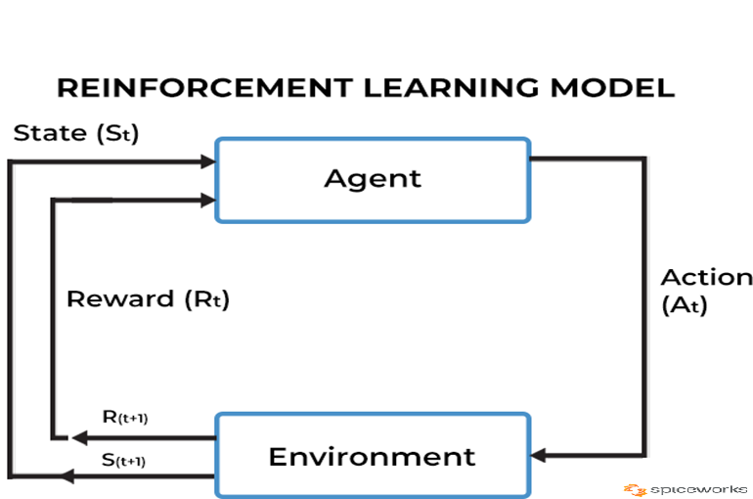
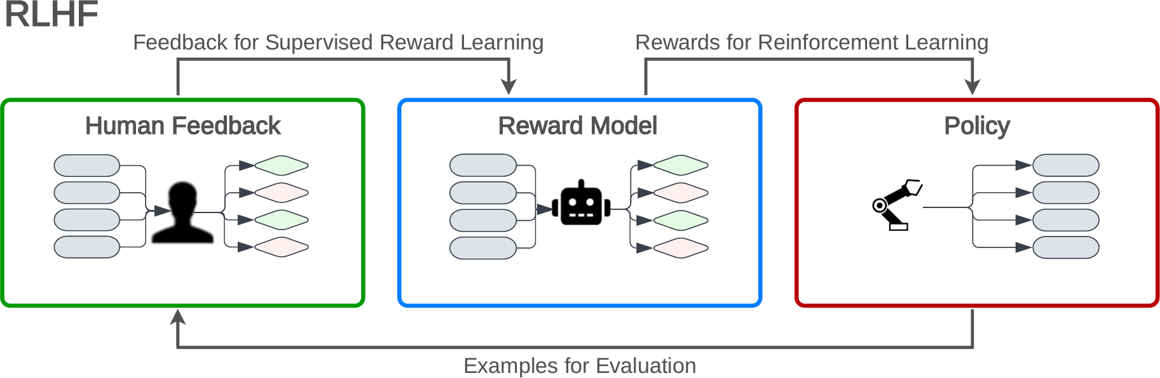
InstructGPT – RL from Human Feedback
Initially, a GPT3 model was instruction tuned using supervised learning on a dataset of instructions paired with ideal responses created manually by human annotators.
The model is further improved using Reinforcement Learning from Human Feedback (RLHF), which tailors the model's responses based on human-provided feedback.
Human annotators rank different responses to the same prompt, and this ranking data is used to train a reward model, which predicts which responses are preferable.
Train LLM using reinforcement learning to maximize expected reward.
ChatGPT is trained by RLHF using the same methods as InstructGPT
https://openai.com/blog/chatgpt/

Slide 40
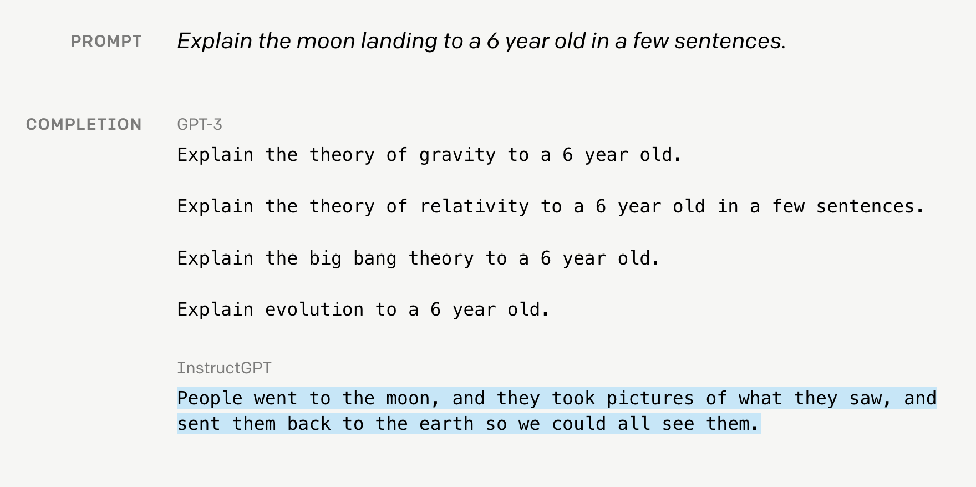
InstructGPT - Example
InstructGPT is better at following explicit instructions than the original GPT-3 making it more suitable for applications where clear, aligned responses to user prompts are crucial.

Slide 41
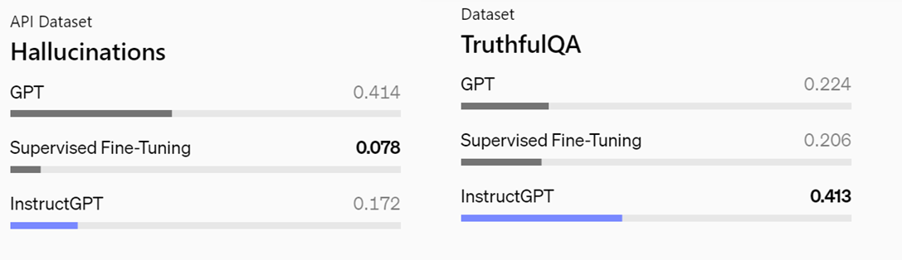
InstructGPT - Results
Compared to GPT-3, InstructGPT produces fewer imitative falsehoods and makes up facts (“hallucinates”) less often
Supervised tuning works well for tasks with objective answers (e.g., diagnosis)
For open-ended tasks (e.g., “Write a story”), purely supervised models might not be flexible enough; however, incorporating RLHF, fine-tunes the model based on human preferences rather than static, labeled responses.

Slide 42
InstructGPT - Challenges
InstructGPT relies heavily on human feedback. Human ratings can be different from person to person
Solution: instead of asking for direct ratings, ask for pairwise comparisons, which can be more reliable. e.g., compare two summary of a text and evaluate which one is better
While InstructGPT performs well on common topics, it may struggle in highly specialized domains where specific knowledge is required.
InstructGPT requires extensive human labor, as annotators must label and rank responses, making it costly and time-consuming.

Slide 43
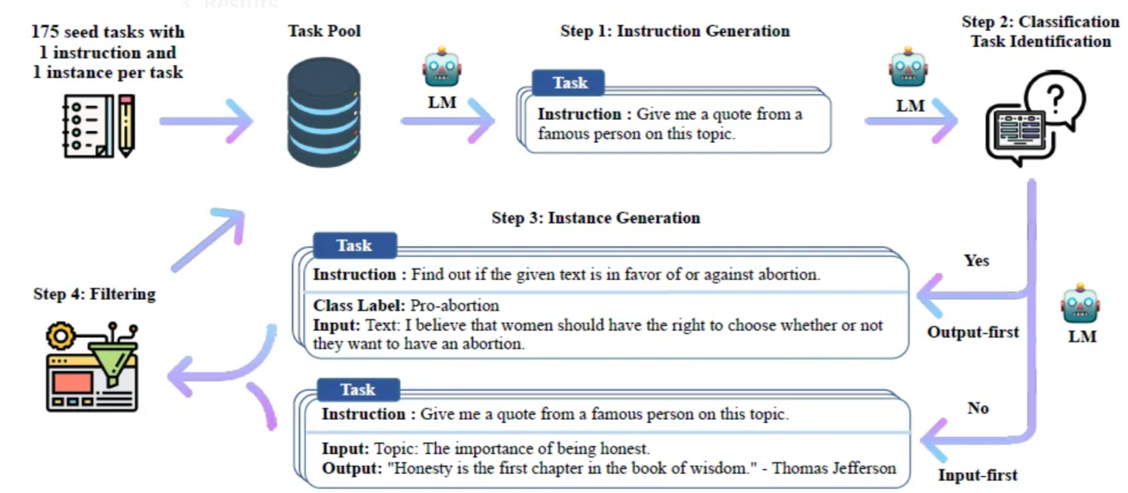
Self-Instruct
Traditionally, instruction-tuning datasets are manually created by collecting examples of instructions along with desired model outputs. This is a labor-intensive process.
The self-instruct method automates the creation of these instruction datasets by using a pretrained LLM to generate both the instructions and the corresponding outputs
Self-generated instructions and training data may vary in quality which needs a filtering mechanism.

Slide 44
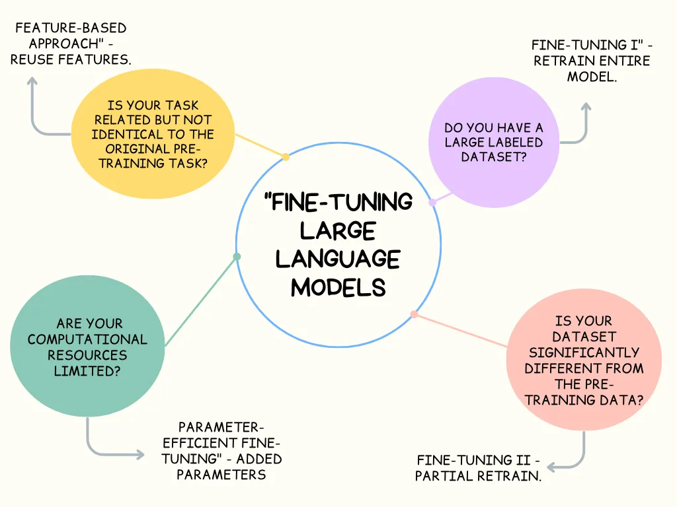
Selecting Fine-tuning Approach
• Different fine-tuning approaches offer varying levels of performance and resource requirements.
• The choice of approach depends on the specific task, available data, and computational resources.
Instruction tuning can be used in combination with other approaches

Slide 45
Best Practices of Fine-Tuning
Start with a well-established pre-trained model
Use a diverse and representative dataset for fine-tuning
Regularly evaluate the model during fine-tuning to prevent overfitting
Consider multi-task training
In open-source LLMs, there are more options of fine-tuning approaches comparing commercial LLMs
In commercial LLMs, more advanced models but less finetuning options are available
The decision on selection of target LLM depends on both complexity of the task and the optimal finetuning approach.

Slide 46
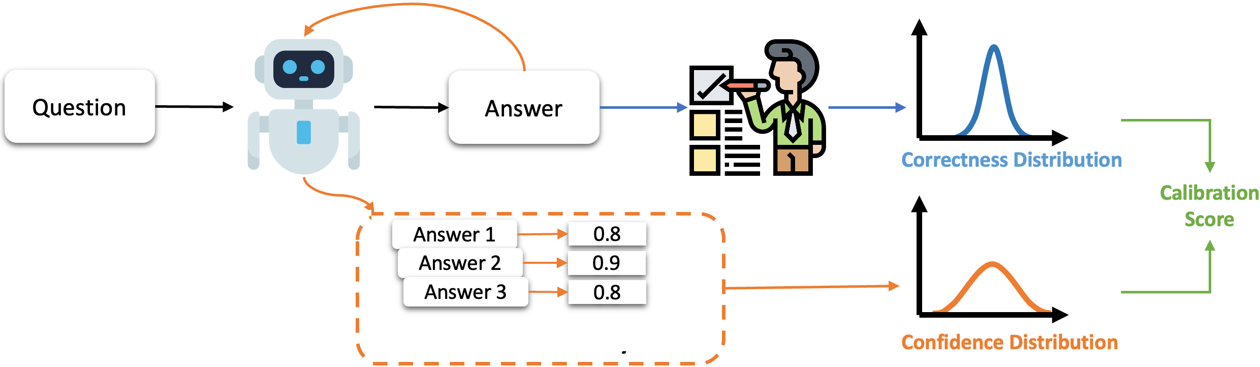
LLM Calibration
Calibration refers to the alignment between a model's confidence in its predictions and the actual correctness of those predictions.
For example, if a model is 90% confident in a prediction, it should be correct approximately 90% of the time when it makes predictions.
If the model is overconfident (e.g., saying it's 90% confident but only being right 60% of the time), or underconfident (e.g., being 90% confident but right 99% of the time), the model is poorly calibrated.

Slide 47
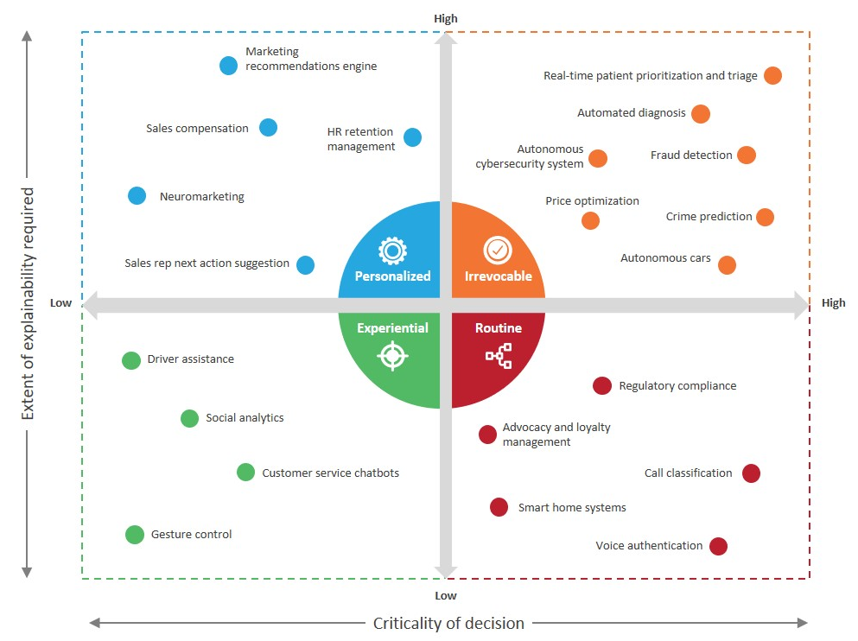
Importance of Calibration
In impactful decisions (like healthcare or autonomous vehicles), decisions made by LLMs need to be as reliable as possible:
For correct prediction, we want the model to output a high probability.
For incorrect prediction, we want the model to be able to say “no, I don’t know that” or a very low probability.

Slide 48
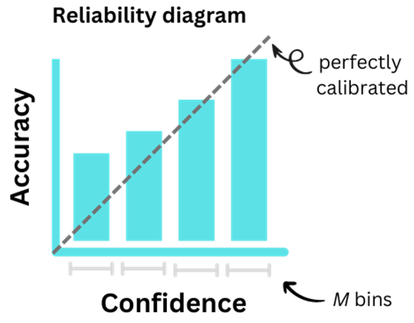
Calibration Metrics
Many measure including Expected Calibration Error (ECE)
LLMs often predict tokens or outputs with confidence scores (probabilities).
ECE groups these predictions into bins and compares accuracy to confidence.

Slide 49

Evaluate Calibration
Record confidence of model’s predictions on test data for each token(e.g., using log-probablities) or classification task (e.g., probability if classification)
Group predictions into confidence intervals (e.g., bins for confidence between 0.0-0.1, ..., 0.8-0.9, 0.9–1.0).
Compute the actual accuracy of the task of each bin besides average confidence of the bin:
Actual accuracy= the fraction of correct predictions within a bin
Confidence = the average of confidences within a bin
Calculate the ECE as a weighted average of the absolute difference between accuracy and confidence across bins.

Slide 50
Evaluate Calibration - Example
Prediction-Id | Confidence (%) | Correct
1 | 95 | 1
2 | 80 | 1
3 | 70 | 1
4 | 90 | 0
5 | 60 | 0
6 | 85 | 1
7 | 55 | 0
8 | 75 | 1
9 | 65 | 0
10 | 50 | 1
Suppose that we use an LLM for diagnosis of diseases based on patient’s condition
Using suitable prompt, we request for probability besides each diagnosis
Suppose that correctness of the results is evaluated by medical doctors

Slide 51

Evaluate Calibration - Example
Bin | Prediction-Id | Confidence (%) in Bin | Correct
50-60% | 7, 10 | 50, 55 | 0, 1
60-70% | 5, 9 | 60, 65 | 0, 0
70-80% | 3, 8 | 70, 75 | 1, 1
80-90% | 2, 6 | 80, 85 | 1, 1
90-100% | 1, 4 | 95, 90 | 1, 0
Bin | Prediction-Id | Avg Confidence (%) | Accuracy
50-60% | 7, 10 | 52.5 | 0.5
60-70% | 5, 9 | 62.5 | 0.0
70-80% | 3, 8 | 72.5 | 1.0
80-90% | 2, 6 | 82.5 | 1.0
90-100% | 1, 4 | 92.5 | 0.5

Slide 52

Evaluate Calibration - Example
2/10 ​× ∣0.5−0.525∣=0.005
2/10 ​× ∣0.0−0.625∣=0.125
2/10 ​× ∣1.0−0.725∣=0.055
2/10 ​× ∣1.0−0.825∣=0.035
2/10 ​× ∣0.5−0.925∣=0.085
ECE=0.005+0.125+0.055+0.035+0.085=0.305

Slide 53


Calibrating LLMs - Temperature Scaling
A post-processing technique where the logits of the model are divided by a "temperature" parameter before being passed through a softmax function.
This approach does not change the predictions themselves but affects the confidence scores.
T=1: the output is the same as the original softmax function.
T>1: reducing overconfidence by spreading the probability mass more evenly
T<1: the output becomes sharper, making the model more confident in its top predictions

Slide 54


Temperature Scaling - Example
Temperature scaling can be applied to an LLM fine-tuned for classification, ensuring the model doesn't output overconfident predictions for uncertain answers.
Examples:
If a model outputs probability of 66% for a class
Apply a temperature T=2, might recalibrated it to 50%
This leads to smoother probabilities, reducing the overconfidence of the original prediction.

Slide 55
Advantages of Temperature Scaling
Simplicity: It is easy to implement and computationally inexpensive and don’t need to retrain the model
Doesn’t Change Order of Predictions: Unlike more complex calibration techniques, temperature scaling does not alter the order of predicted class, only the confidence score.
Instability of outcomes: Higher temperature might produce unstable results which is not desirable for some tasks
Limited Flexibility: Applies a uniform adjustment for all classes, which may not be optimal if miscalibration varies across classes.

Slide 56

Calibrating LLMs - Platt Scaling
A form of logistic regression applies to the output probabilities.
Logistic model is trained to the predicted probabilities to better align them with actual outcomes:
Collect LLM outputs on a validation dataset for prediction of a class
Use these outputs along with the true labels to train a logistic regression model for each class
During training, the models learn how to produce correct output probabilities from input probabilities
In multiclass classification, Platt Scaling requires fitting a separate calibration model for each class.
This can increase the risk of inconsistencies .

Slide 57

Calibrating LLMs - Ensembles
Using multiple models to improve prediction accuracy and confidence estimates by averaging the predictions from different models.
This method provides more stable results and better-calibrated confidence scores, addressing the over-confidence or under-confidence that a single model might exhibit.
Ensembles are particularly useful in calibrating large language models (LLMs) and other deep learning systems where calibration is critical for making reliable decisions.

Slide 58
Project
Finetuning Commercial LLMs for Emergency Medicine

Slide 59

LLMs for MEDSS
Commercial vs Academic : Capabilities of commercial LLMs are not comparable with academic or open-source solutions because of huge investments of big-techs on these models
Collaborative vs Proprietary: Each big-tech tries to promote their own proprietary model rather than collaborating with other big-techs
General Medicine vs Emergency Medicine: Decision support is more important in Emergency Medicine since time and available medical experts are very limited. MEDSS can be a lifesaver
1,2,3→ Opportunity : There is a good opportunity to introduce domain-specific medical solutions by leveraging strength of various LLMs for MEDSS

Slide 60


LLM vs Traditional ML
Our literature review shows significant advantages of LLMs over traditional ML in diagnoses and treatments
https://doi.org/10.1371/journal.pdig.0000341

Slide 61

Which LLM?
Recently many LLMs capable of efficient medical diagnosis introduced to the market
LLMs pre-trained on different data sources with different range of diseases, patient demographics, etc. provide them different diagnostic capabilities
Educated guess : Aggregated capabilities of a cluster of LLMs in diagnosis and treatment outperform each individual LLM

Slide 62


Single vs Collective - Primary Results
From 300 cases of medical emergency only 43 cases (13.66%) were diagnosed wrong by all AI engines
In 159 cases (53%) some of AI engines provide wrong diagnosis.
The best performance of an individual engine is provided by Claude (28% wrong diagnosis).
1,2,3 → The collective capabilities of LLMs in diagnosis is stronger than each individual LLM.

Slide 63

Problem Statement
How can we take advantage of collective capabilities of LLMs?
1- A list of results of all LLMs
Very difficult for doctors in medical emergency to decide which diagnosis is the best if there are different diagnosis from different LLMs
By introducing new LLMs the list will be very large, and most of them can not be reviewed by doctors in medical emergency
2- One optimal result using best outcomes of LLMs
Needs a method to learn different capabilities of LLMs for different type of diseases , demographic, etc.
Needs to integrate results in a way that reflect best outcomes of a group of LLMs (e.g., results might contain diagnosis from one LLM, treatment from the other one, and complementary information from another one)

Slide 64

Super Learner (SL) of LLM Overall view
Meta Learner is an ML model (e.g., a kind of Neural Network) which learns how to produces desired outputs from inputs (outputs of fine-tuned LLMs) through training process
Meta Learner can be Black-box or White-box

Slide 65


Why Fine-Tuning?
LLMs trained on general query/responses since they are general-purpose models, hence, they are not completely aligned with requirements of a specific domain of medicine such as emergency medicine (e.g., the prescription of an antibiotic is not enough, we need exact dosage, timing, etc.)
Fine-tuning on domain-specific data is required (real emergency data is available in our project)

Slide 66

Fine-Tuning Data

Slide 67
Fine-Tuning Approach
Full Fine-Tuning:
Since enough resources are available on Cloud and complex medical diagnosis needs comprehensive tuning
Instruction Tuning:
Size of fine-tuning data is small.
Diagnosis is a kind of question answering which is aligned well with instruction tuning

Slide 68
Fine-Tuning Setup (Step 1)
1. Download the following file as the fine-tuning dataset:
FineTuning_Data.csv
2. Download the following file as the test data:
Test_Data.xlsx
3. Choose a model and a setting containing two sets of hyper-parameters for the first and second finetuning
(Each combination of model + setting can be chosen by just one group)
4. Sign up on one of the following websites based on the selected model:
https://aistudio.google.com
https://platform.openai.com/chat-completions

Slide 69
Before Finetuning (Step2)
Add instruction to the start of all queries in Test_data (both New Samples and Finetuned Samples)
Use the prompt of the original model for all cases in New Samples and Finetuned Samples
Just consider first diagnosis as the result
If the results is not the same as “correct diagnosis” categorize the response as Wrong (ignore treatment column)
Report the overall results.

Slide 70


Fine-tuning (Step 3)
Add instructions to the start of all queries
Convert the CSV file to Json (if required)
Fine tune the model using the specified hyper-parameters
Report Training Loss chart

Slide 71
After Fine-tuning (Step 4)
Use GPT / Playground or Gemini /Use in Chat to get a prompt of the finetuned model
Use the prompt of the fine-tuned model for all cases in New Samples and Finetuned Samples of Test_Data (containing instructions)
Just consider first diagnosis as the result
If the results is not the same as “correct diagnosis” categorize the response as Wrong (ignore treatment column)
Report the overall results.

Slide 72
Repeat Process and Compare Results (Step 5)
For the second set of hyper-parameters repeat steps 3 and 4
Upload filled Excel file of Test_Data for both set of hyper-parameters
Compare the results of two fine-tuned models in your presentation file

